Slide 1
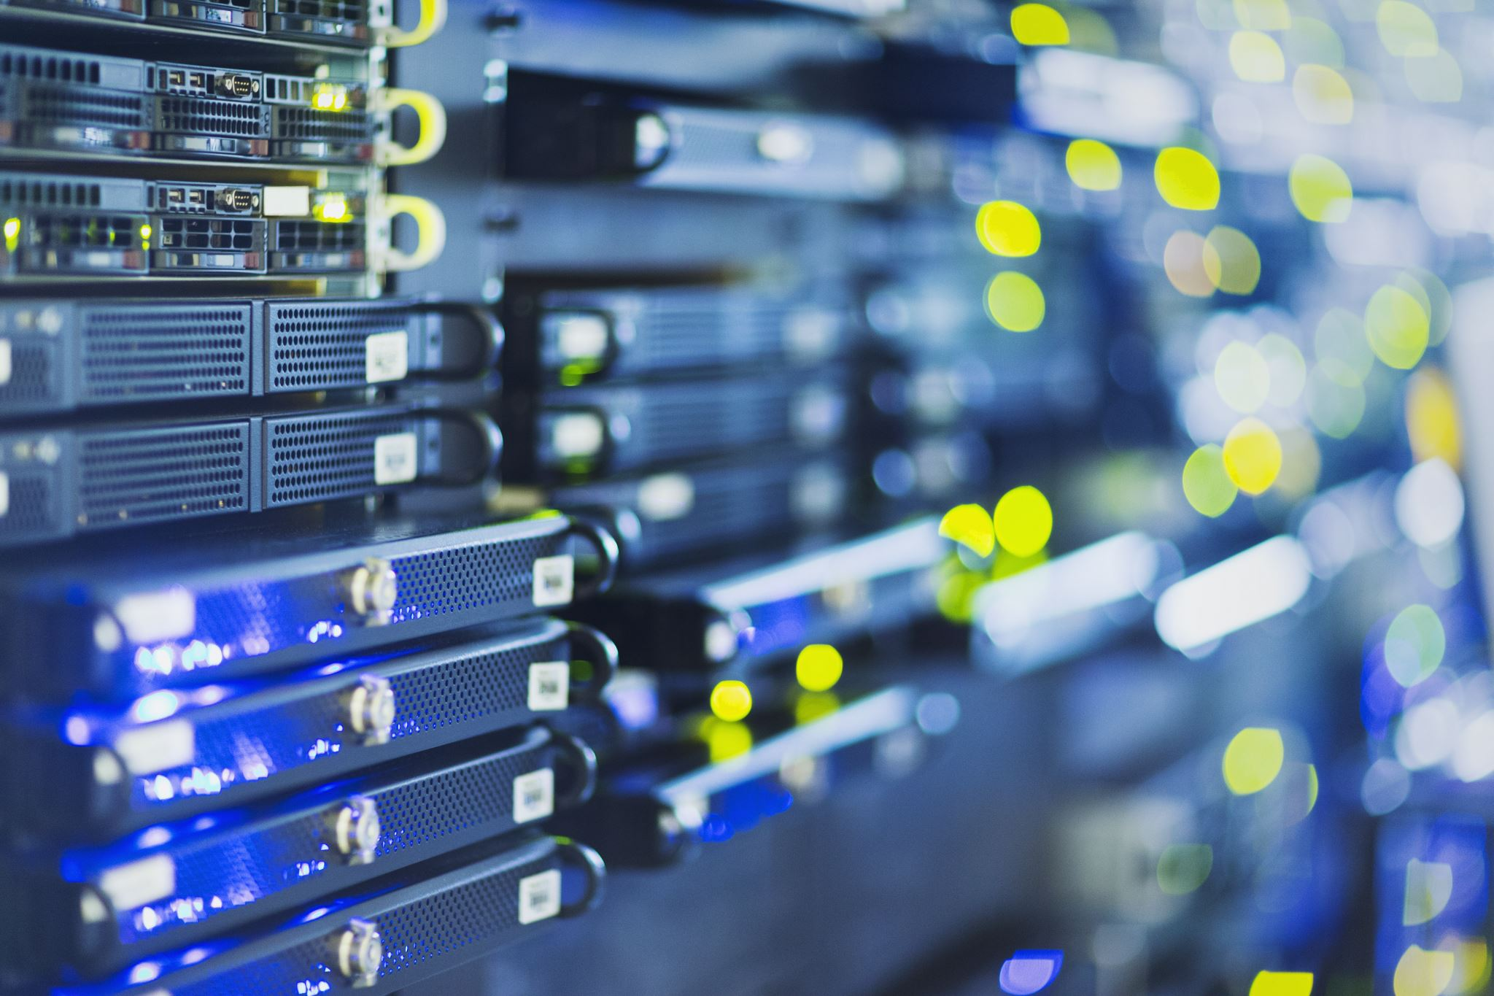
Firewall & VPN

Slide 2
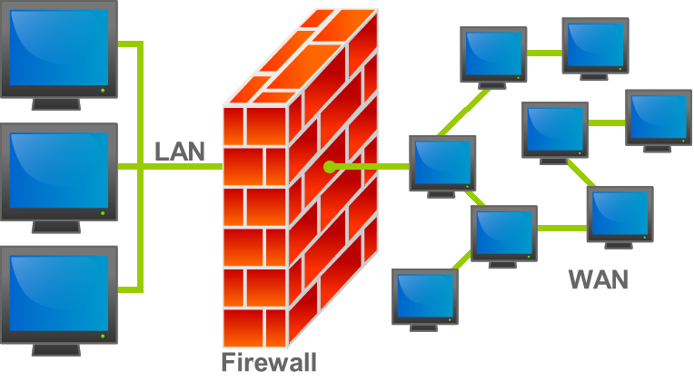
Firewall
A firewall is a network security device that monitors incoming and outgoing network traffic and decides whether to allow or block specific traffic based on a defined set of security rules.
They establish a barrier between secured and controlled internal networks that can be trusted and untrusted outside networks, such as the Internet.

Slide 3
Firewall
A firewall can be hardware, software, or both
A hardware firewall is configured with two or more network interfaces, typically placed between a corporate LAN and the WAN connection
A software firewall is installed in an OS and inspects all packets coming into or leaving the computer

Slide 4
Firewall
Routers can be used as firewalls
Network administrators can create rules, called access control lists (ACLs), that deny certain types of packets
ACLs can examine many of the same packet properties that firewalls can
An intrusion detection system (IDS) usually works with a firewall or router

Slide 5
Types of Firewall
Packet filtering Firewall
Packet Filtering Firewall is a firewall technique used to control network access by monitoring outgoing and incoming packets and allowing them to pass or halt based on the source and destination Internet Protocol (IP) addresses, protocols and ports.

Slide 6
Types of Firewall
Proxy firewall
A proxy firewall serves as the gateway from one network to another for a specific application. Proxy servers can provide additional functionality such as content caching and security by preventing direct connections from outside the network.

Slide 7
Types of Firewall
Stateful inspection firewall A stateful inspection firewall allows or blocks traffic based on state, port, and protocol. It monitors all activity from the opening of a connection until it is closed. Filtering decisions are made based on both administrator defined rules as well as context.

Slide 8
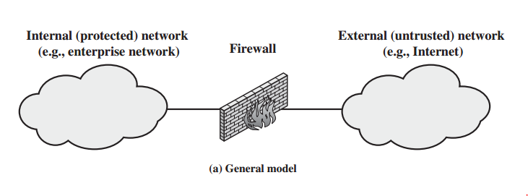
Types of Firewall

Slide 9
Virtual Private Networks (VPN)

Slide 10
Virtual Private Networks (VPN)
A virtual private network (VPN) is a network connection that uses the Internet to give users or branch offices secure access to a company’s network resources
Provides an encrypted tunnel between the two private networks
Usually cheaper than a private leased line.
Once established and as long as the encryption remains secure the VPN is impractical to exploit

Slide 11
Securing Communication with VPN
VPNs use encryption technology to ensure the communication is secure while traveling through the public Internet
A “tunnel” is created between the VPN client and VPN server
VPN servers can be configured on server OSs or they can be in the form of a dedicated device with the sole purpose of handling VPN connections

Slide 12
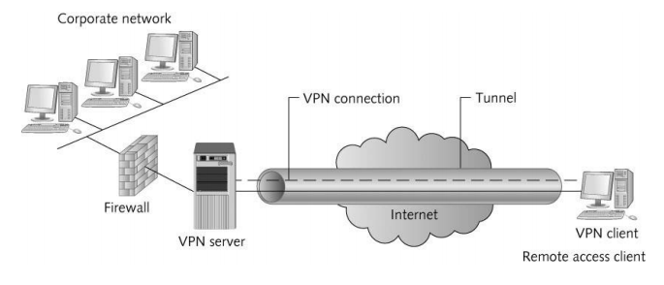
Securing Communication with VPN

Slide 13
VPN Benefits
VPN benefits include the following:
Enable mobile users to connect with corporate networks securely wherever an Internet connection is available
Allow multiple sites to maintain permanent secure connections via the Internet instead of using expensive WAN links
Can reduce costs by using the ISP’s support services instead of paying for more expensive WAN support

